Slide 1
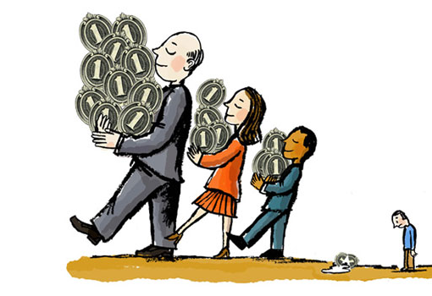
Poverty and Income Gap
Presented by : Vinay, Pallavi, Vikash

Slide 2
So let's have a basic overview of how we can define poverty.

Slide 3
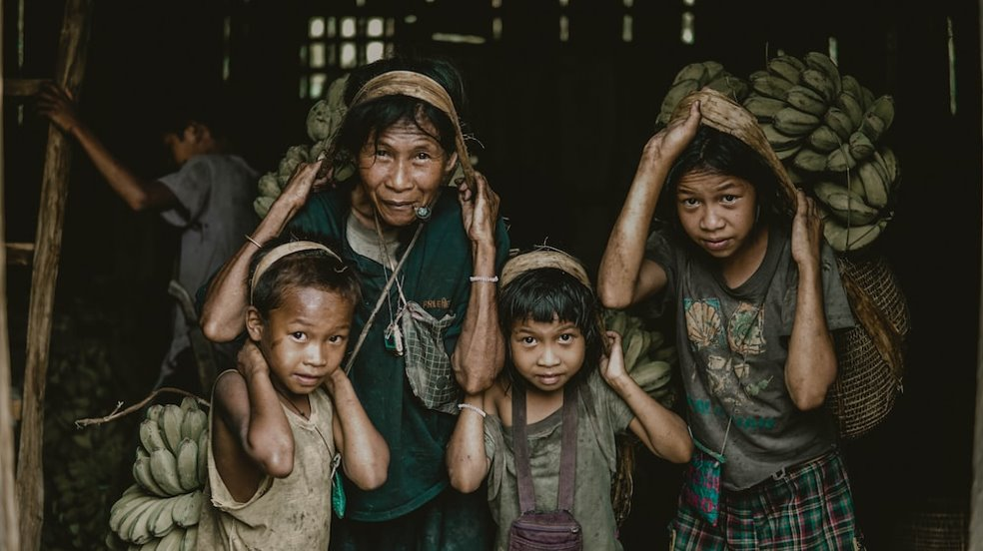
What's Poverty?
Lack of access to basic necessities such as food, shelter, clothing, and healthcare due to a lack of resources and opportunities.
Poverty is relative --> BPL.
Struggle to live normal life.

Slide 4
Selective Distribution
of resources.
Globalization and economic changes
2
4.
Reasons of poverty
1.
3.
5.
Systematic racism and discrimination
Cost of living in the industrial world
Industrialism and Government policies.

Slide 5
Vicious cycle of poverty
We need to look how poverty induces more poverty. Society is formed in a way that it favors rich become richer and poor become poorer(control of rich over policy, government).
Video

Slide 6
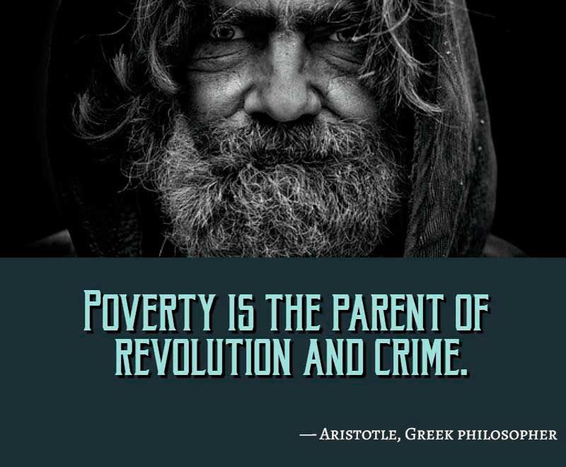


Slide 7
In human nature, inequality is more natural than equality, for example we won't get same grades in this course.
Inequality is due to 2 reasons mainly i.e.,
Based on talent/ efforts - Fair.
Unequal Opportunity - Unfair.
Is inequality Fair?

Slide 8
SOCIAL IMPACT OF POVERTY
Increased no. of crime.
Naxalites in India.
Militancy in Kashmir.
Health
Feeling of Alienation
Political Instability
Family and Community Breakdown

Slide 9

Do rich pay taxes?

Slide 10
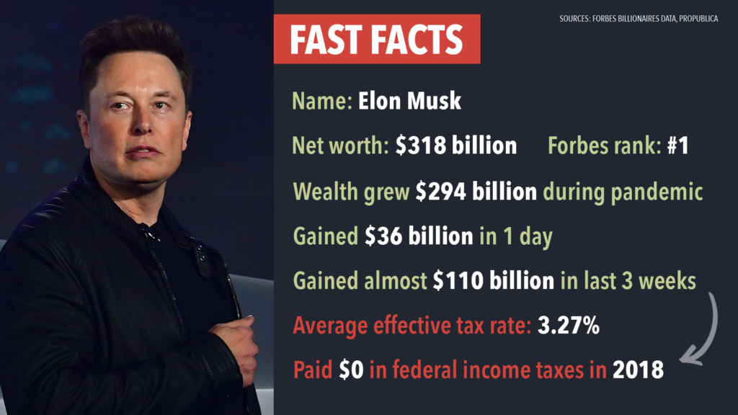
Paid $0 in federal Income
taxes in 2018

Slide 11
Corporation – A escape route for rich.
Rich always either make or find loopholes in the system to not pay taxes.

Slide 12
Theories on poverty given by sociologists
Structural-functional theory -->
-->natural consequence of an unequal distribution of resources. -->necessary function of society.
Conflict theory--> --> result of the struggle between the powerful and the powerless. --> powerful use their power to keep others in poverty.
Social constructionist theory --> --> poverty is not an objective, absolute condition. -->It is socially constructed phenomenon that is shaped by cultural norms and values.
Culture of poverty theory --> --> poverty is perpetuated by a culture that promotes and reinforces certain behaviors and attitudes, such as fatalism, apathy, and a lack of ambition.

Slide 13
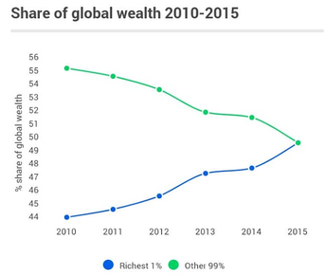
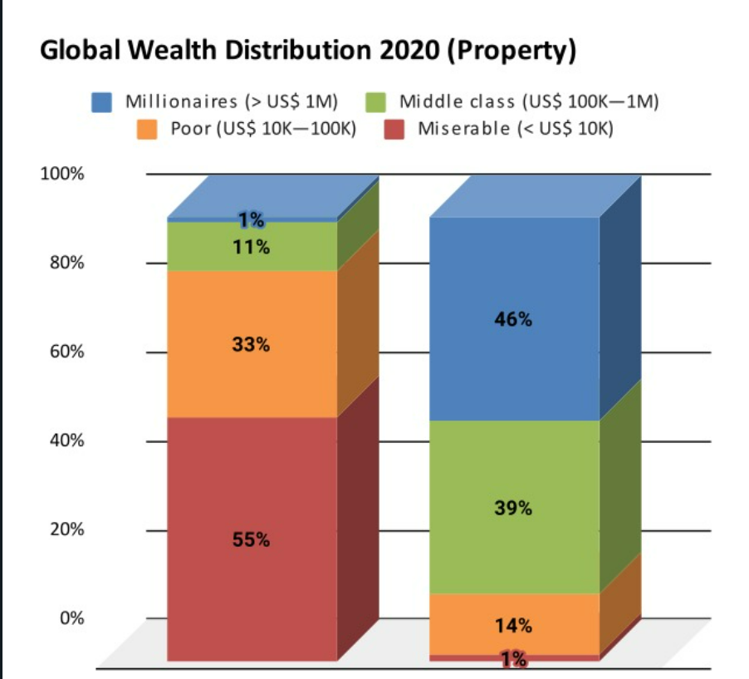
The COVID-19 pandemic has likely had an impact on global wealth distribution, as the economic downturn and job losses caused by the pandemic have hit lower-income groups particularly hard. Source 3 Source 1 Source 2

Slide 14
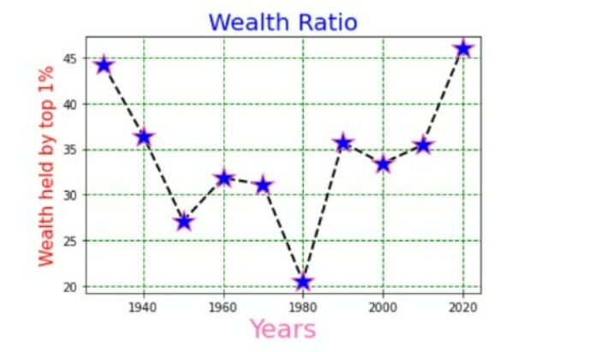
Wealth Inequality--> Drop ? -->The big drop is being associated with the drop in stock market in the 1970. -->Stock market was depressed in 1976-1980. -->After great recession top 1% of the population grows 34.6 % to 37.1%. --> Great recession started in 2007. --> Huge ration -> stock market overvalued (1929). Source Source 2

Slide 15
Conclusion
Can we say Merit has increased?

Slide 16
Thanks!
Here is the link of Document we use to make our PPT, we have taken refrences form Google Scholar articles, Famous News Outlets and Magzines.
https://docs.google.com/document/d/1IQvWm-7zuTAr8X_hJQqa-X7EBR8ih7mz77PLkuNsYH4/edit?usp=sharing
We haven't included text in PPT. As in presentation, we were supposed to speak without seeing all the text.

